Slide 1
Angular Form Validation

Slide 2
Angular Forms
Forms are an integral part of a web application.
Practically every application comes with forms to be filled in by the users.
Angular forms are used to log in, update a profile, enter sensitive information, and perform many other data-entry tasks.

Slide 3
Types of Angular Forms
two types of form building supported by Angular Forms.
Template-Driven Approach
Reactive Approach

Slide 4
Template-Driven Approach
In this method, the conventional form tag is used to create forms.
Angular automatically interprets and creates a form object representation for the tag.
Controls can be added to the form using the NGModel tag.
Multiple controls can be grouped using the NGControlGroup module.
A form value can be generated using the “form.value” object.
Form data is exported as JSON values when the submit method is called.
Basic HTML validations can be used to validate the form fields.
In the case of custom validations, directives can be used.

Slide 5
Reactive Form Approach
This approach is the programming paradigm oriented around data flows and propagation of change.
With Reactive forms, the component directly manages the data flows between the form controls and the data models.
Reactive forms are code-driven, unlike the template-driven approach.
Reactive forms break from the traditional declarative approach.
Reactive forms eliminate the anti-pattern of updating the data model via two-way data binding.
Typically, Reactive form control creation is synchronous and can be unit tested with synchronous programming techniques.

Slide 6
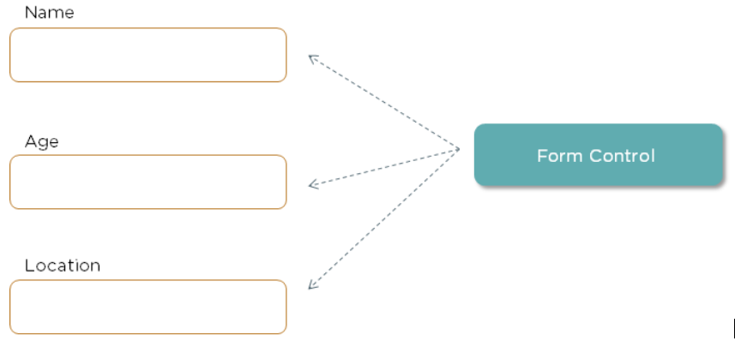
Form Control
Form Control is a class that enables validation. For each input field, an instance of this class is created. These instances help check the values of the field and see if they are touched, untouched, dirty, pristine, valid, invalid, and so on.

Slide 7
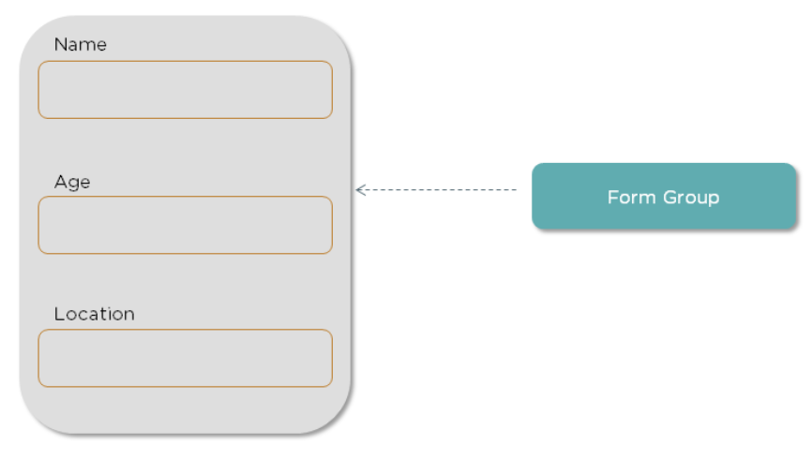
Form Group
FormGroup class represents a group of controls. A form can have multiple control groups. The Form Group class returns true if all the controls are valid and also provides validation errors, if any.

Slide 8
Step 1: Make one Angular Project.
ng new ngValidation

Slide 9
Step 2: Make one form inside app.component.html
<div class="container">
<h1> Welcome to {{title}}!! </h1>
<form [formGroup]="angForm" novalidate>
<div class="form-group">
<label>Name:</label>
<input class="form-control" formControlName="name" type="text">
</div>
<div *ngIf="angForm.controls['name'].invalid && (angForm.controls['name'].dirty || angForm.controls['name'].touched)" class="alert alert-danger">
<div *ngIf="angForm.controls['name'].errors?.['required’]”> Name is required. </div>
</div>
<div class="form-group">
<label>Address:</label>
<input class="form-control" formControlName="address" type="text">
</div>
<div *ngIf="angForm.controls['address'].invalid && (angForm.controls['address'].dirty || angForm.controls['address'].touched)" class="alert alert-danger">
<div *ngIf="angForm.controls['address'].errors?.['required’]”> email is required. </div>
</div>
<button type="submit"
[disabled]="angForm.pristine || angForm.invalid" class="btn btn-success"> Save </button>
</form>
<br />
<p>Form value: {{ angForm.value | json }}</p>
<p>Form status: {{ angForm.status | json }}</p> </div>

Slide 10
App.component.ts
import { Component } from '@angular/core';
import { FormGroup, FormBuilder, Validators } from '@angular/forms';
@Component({
selector: 'app-root',
templateUrl: './app.component.html',
styleUrls: ['./app.component.css']
})
export class AppComponent {
title = 'ngValidation';
angForm!: FormGroup;
constructor(private fb: FormBuilder) {
this.createForm();
}
createForm() {
this.angForm = this.fb.group({
name: ['', Validators.required ],
address: ['', Validators.required ]
});
}
}

Slide 11
App.module.ts
import { NgModule } from '@angular/core';
import { BrowserModule } from '@angular/platform-browser';
import { FormsModule, ReactiveFormsModule } from '@angular/forms';
import { AppRoutingModule } from './app-routing.module';
import { AppComponent } from './app.component';
@NgModule({
declarations: [
AppComponent
],
imports: [
BrowserModule,
AppRoutingModule,
FormsModule,
ReactiveFormsModule,
],
providers: [],
bootstrap: [AppComponent]
})
export class AppModule { }

